Slide 1
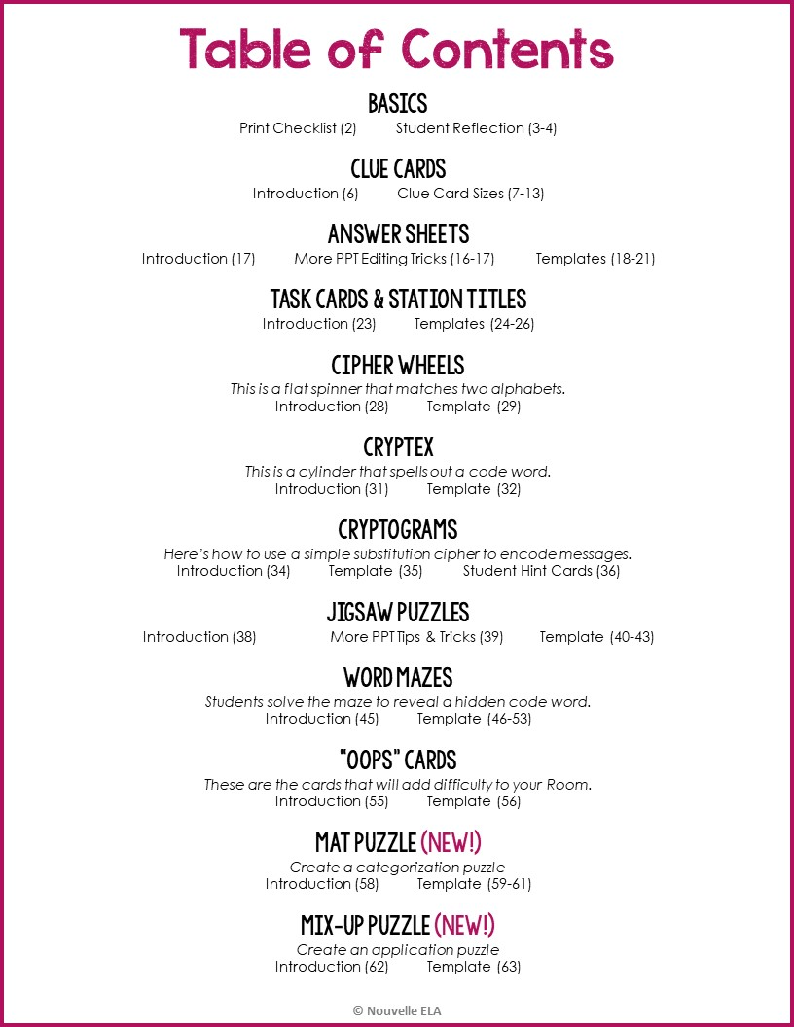

Slide 2

 | To Print | Considerations
 | Station Titles | 1 copy (on cardstock if possible), to be used throughout the day.
 | Task Descriptions | 3 copies (on cardstock if possible). Place two at each station, and keep a spare copy for yourself in case a card gets damaged.
 | Clue Cards | 1 copy per group. It will be easier for you to reset the room between classes if you have a fresh copy of all of the clue cards. Instead of having to sort the sets of cards used by your previous class, you can just start over hiding them, etc. You don’t have to do this – you can also have students help you put the clues back. PREP NOTE: If you decide to “hide” some clues, make sure you cut them out in advance to make resetting the room faster.
 | Jigsaw Puzzles | 5-6 copies for the station, to be used throughout the day. It will work best if each group can look at their own at the station. PREP NOTE: You should put the pieces in an envelope or plastic baggie and have students put everything back after they’ve finished.
 | Code Wheels or other Tools | 4 models (on cardstock, if possible). Place three at the station, and keep a spare copy for yourself in case one gets damaged. Students may have to share these, but they will complain about other teams slowing them down if you don’t have more than one.
 | Close Reading Passage | 1 copy per group for every class. (If we truly want to encourage students to underline and annotate as they take standardized tests, it makes sense to allow them to write on this paper, too.) You can also use sheet protectors and dry erase markers to decrease your printing.
 | Answer Sheet | 1 per student. Students should write in pencil. You may also want to provide one clean copy per group.
 | “Oops” Cards | (optional) Choose the length of time you’d like students to remain out of the game and print 3 copies of the appropriate page on cardstock if possible. You’ll reuse these throughout the day.
Editable Checklist
Edit for the puzzles you’ve made
Reminder:
You’ll need to save everything as
.pdf before you print. If you don’t do this, items may not print correctly.
(Delete this box)

Slide 3

1. What did you think this game would be like before you started? Did you have a strategy at the beginning?
How did your team work together? Did someone emerge as a leader?
1. What did you think this game would be like before you started? Did you have a strategy at the beginning?
How did your team work together? Did someone emerge as a leader?

Slide 4
What were your favorite puzzles? Which parts of the game were more difficult?
If you were to do another activity like this, how would you adapt your strategy?
Anything else you’d like to add?
What were your favorite puzzles? Which parts of the game were more difficult?
If you were to do another activity like this, how would you adapt your strategy?
Anything else you’d like to add?

Slide 5
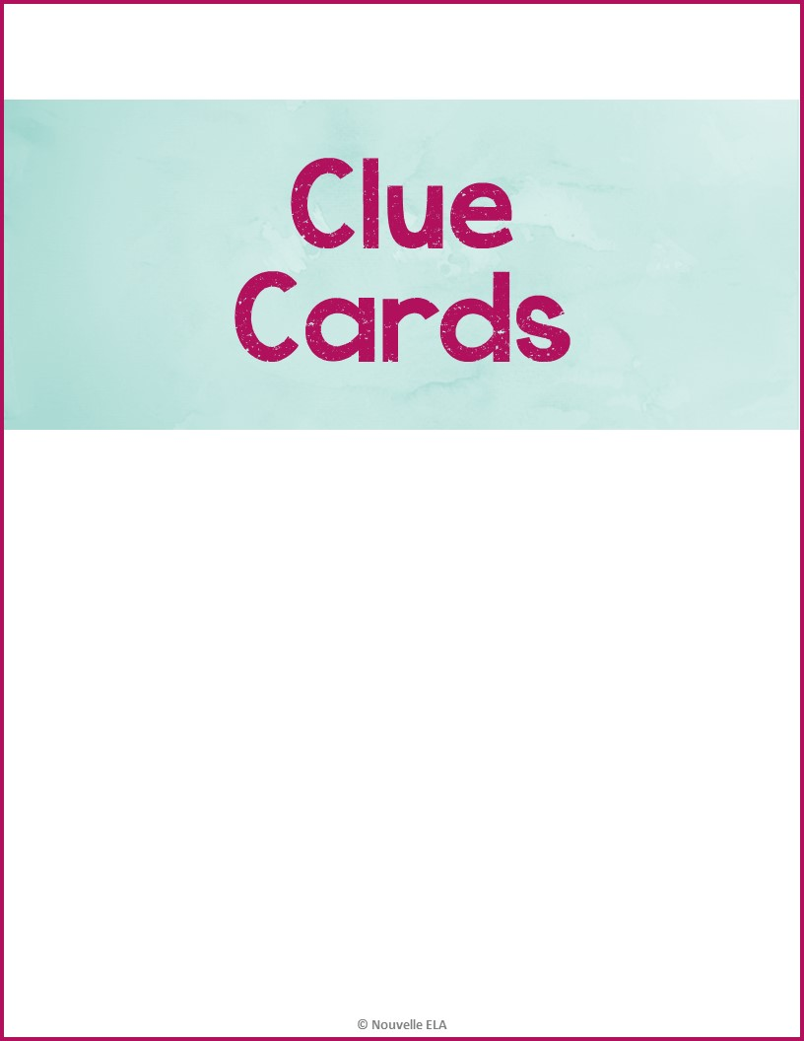

Slide 6
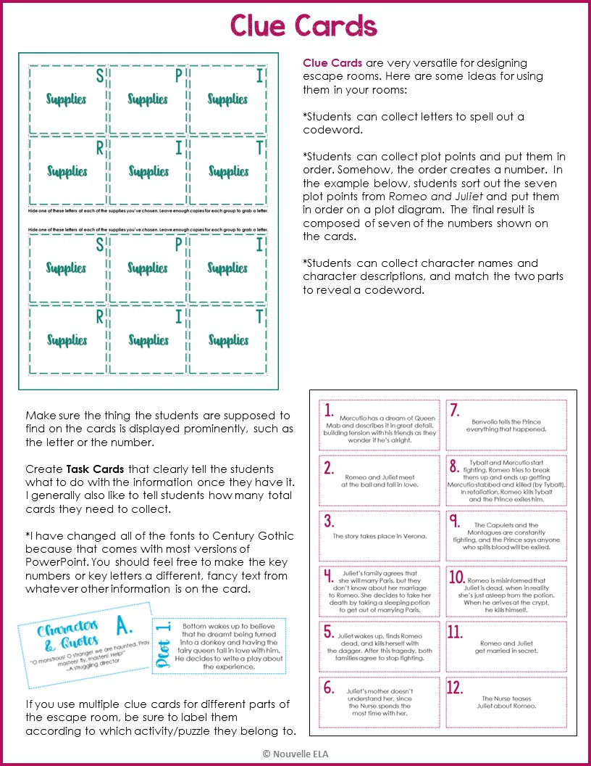

Slide 10
S
P
I
Supplies
Supplies
Supplies
R
I
T
Supplies
Plot
Supplies
Hide one of these letters at each of the supplies you’ve chosen. Leave enough copies for each group to grab a letter.
Hide one of these letters at each of the supplies you’ve chosen. Leave enough copies for each group to grab a letter.
S
P
I
Supplies
Supplies
Supplies
R
I
T
Supplies
Supplies
Supplies

Slide 11
Type here | Type here
Type here | Type here
Type here | Type here
Type here | Type here
1.
5.
2.
6.
3.
7.
4.
8.

Slide 12
Type here | Type here
Type here | Type here
Type here | Type here
Type here | Type here
Type here | Type here
1.
6.
2.
7.
3.
8.
4.
9.
5.
10.

Slide 13
1.
Type here | Type here
Type here | Type here
Type here | Type here
Type here | Type here
Type here | Type here
Type here | Type here
7.
2.
8.
3.
9.
4.
10.
5.
11.
6.
12.

Slide 14


Slide 15
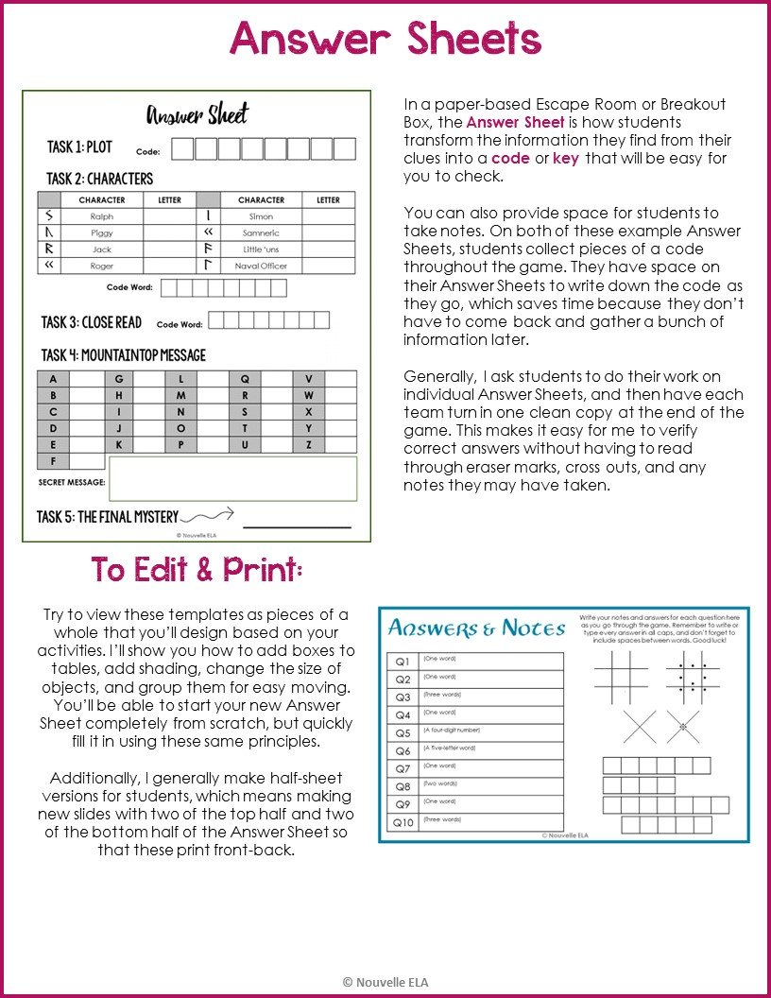

Slide 16
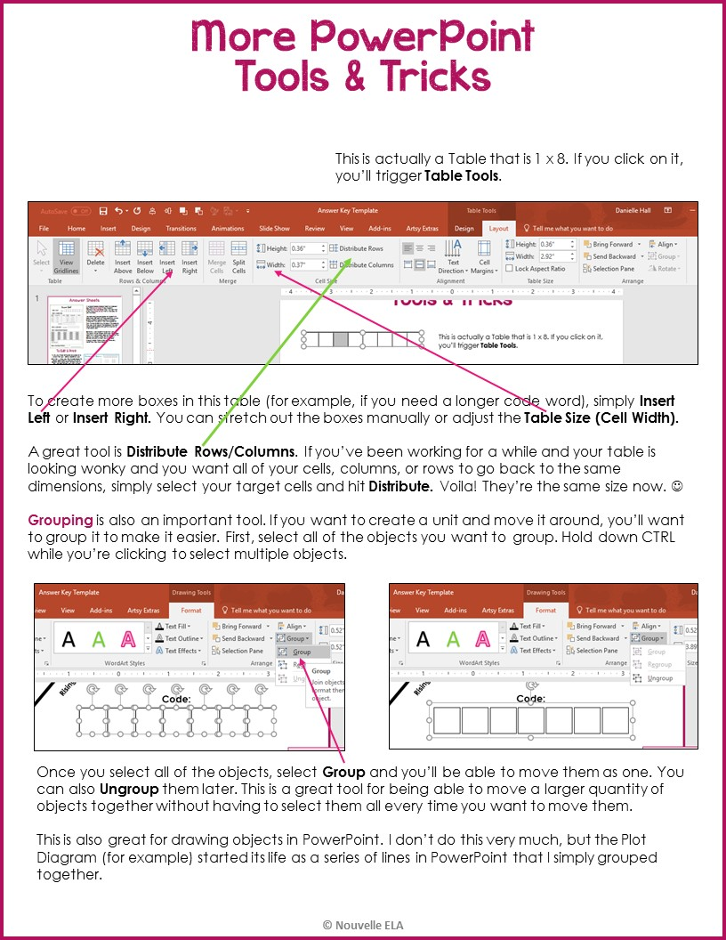

Slide 17
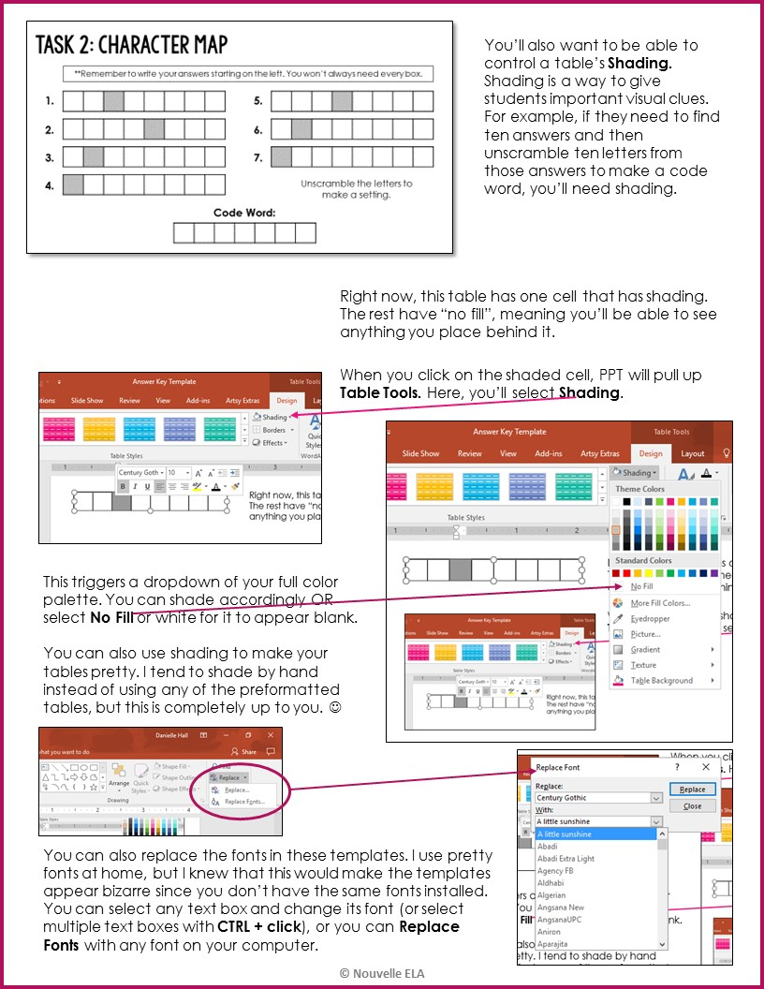

Slide 18
Answer Sheet
TASK 1: PLOT
You can have students find plot points hidden on Clue Cards in the room. You can hide some or all of the cards, and then have them put them in order. Once students identify the Exposition, Rising Action, Climax, Falling Action, and Resolution, the seven numbers will make a full code number.
Other adaptations: This works for anything that needs to be put in order. This could be steps in a process, historical events, anything with orders of magnitude, etc.
Climax
Falling Action
Rising Action
Resolution
Code:
Exposition
TASK 2: CHARACTER MAP
You can have students work on puzzles that have names or words as answers. Highlight letters from these that will spell out a word (either directly, or via unscrambling). Shade these boxes by selecting them and using Table Tools -> Design -> Shading.
Here, I kept all of the answer boxes having the same number of squares, even though the correct answers are different lengths. This keeps students from hacking the puzzle – they simply write the correct answers from left to right and ignore unused boxes.
Other adaptations: This works for anything that generates words or names as answers, so it could work for a wide range of subjects and puzzles.
**Remember to write your answers starting on the left. You won’t always need every box.
1.
5.
2.
6.
3.
7.
4.
Unscramble the letters to make a setting.
Code Word:

Slide 19
Answer Sheet
TASK#3: QUOTES
Speaker | Scene | Speaker | Scene
1. |  | 9.
2. |  | 10.
3. |  | 11.
4. |  | 12.
5. |  | 13.
6. |  | 14.
7. |  | 15.
8.
In this puzzle, students are basically transforming information into a number. They identify the speaker of each quote from Romeo & Juliet and then identify the act and scene number. 3.2 becomes “32” and 1.4 becomes “14”.
If you have a combination lock you’d like to use, this type of puzzle translates perfectly to that.
Other adaptations: This works for anything you can translate into a number. For example, students could come up with an element that fits a description and then look up its atomic number to create a code.
Code:
Romeo’s 3rd Quote | Nurse’s 1st Quote | Tybalt’s 2nd Quote
TASK 4: CLOSE READ
The concept here is a series of multiple-choice questions whose answers spell out a code word. You can make the letters of the multiple-choice anything you want (For example, options S, P, O, or E) to help spell out your desired codeword.
Students then write the code in the designated boxes on the Answer Sheet. The revealed word is the key for the level.
Code Word:
Congratulations!
You have all four keys

Slide 20
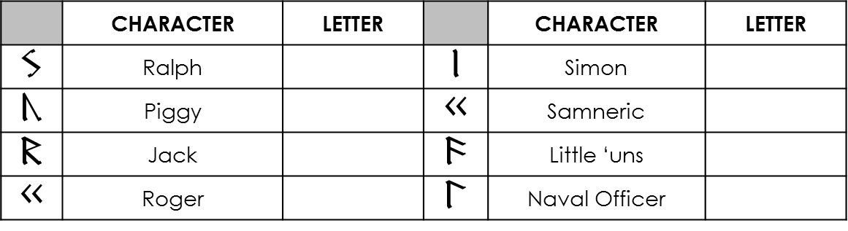

Answer Sheet
TASK 1: PLOT
Code:
TASK 2: CHARACTERS
 | CHARACTER | LETTER |  | CHARACTER | LETTER
 | Ralph |  |  | Simon
 | Piggy |  |  | Samneric
 | Jack |  |  | Little ‘uns
 | Roger |  |  | Naval Officer
In this puzzle, students match the characters listed here with descriptions hidden throughout the classroom. Each clue card has a letter on it.
I wrote the Mountaintop Message using a Germanic Runes font that I downloaded to make it look like a code. Once I had that font, I peppered clues throughout the rest of my Escape Room. Students uncover some of the code in this puzzle. Once they match the letters from the Character Descriptions to the correct character, they can fill in those letters on the alphabet chart below.
When you go to dafont.com or fontspace.com, you can search for fonts to use for codes. I’ve used Germanic and Viking Runes, Pigpen, and Morse Code fonts.
Code Word:
TASK 3: CLOSE READ
Code Word:
TASK 4: MOUNTAINTOP MESSAGE
A |  | G |  | L |  | Q |  | V
B |  | H |  | M |  | R |  | W
C |  | I |  | N |  | S |  | X
D |  | J |  | O |  | T |  | Y
E |  | K |  | P |  | U |  | Z
F
SECRET MESSAGE:
TASK 5: THE FINAL MYSTERY

Slide 21

 |  |  | 4
 |  |  |  |  |  |  | 8
 |  |  |  | 5
 |  |  |  |  |  |  |  | 9
 |  |  |  |  | 6
 |  |  |  |  |  |  |  |  | 10
 |  |  |  |  |  | 7
 |  |  |  |  |  |  |  |  |  | 11

Slide 22


Slide 23
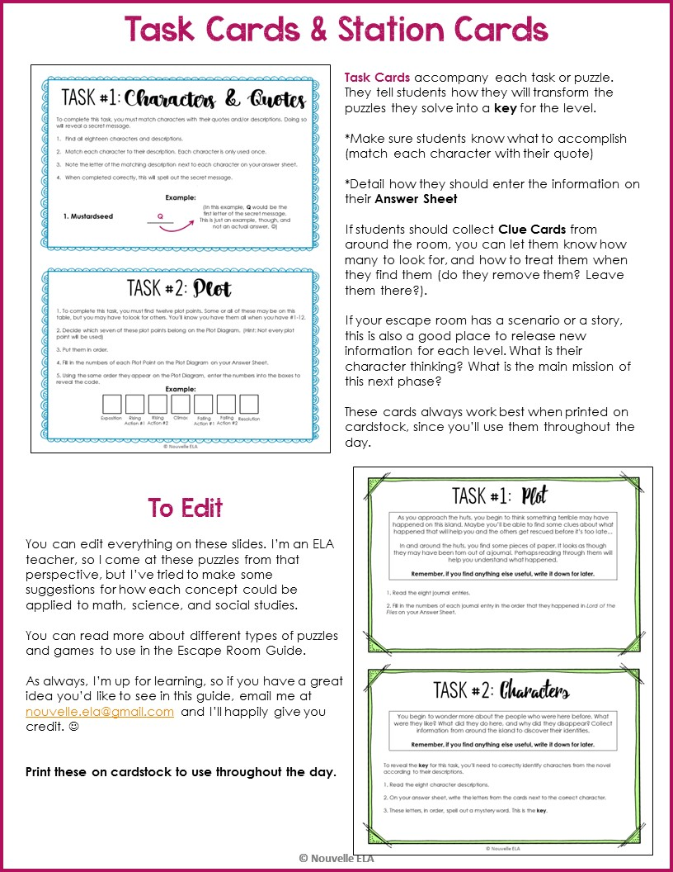

Slide 24
Matching
To complete this task, you must match characters with their quotes and/or descriptions. Doing so will reveal a secret message.
Find all eighteen characters and descriptions.
Match each character to their description. Each character is only used once.
Note the letter of the matching description next to each character on your answer sheet.
When completed correctly, this will spell out the secret message.
In this activity in my A Midsummer Night’s Dream Escape Room, students matched characters to their descriptions. The letters, when entered correctly, spelled out a quote from the play.
Other Adaptations: You could use this set-up to match vocabulary and definitions, famous figures and what they accomplished, etc.
(Delete this box)
Example:
(In this example, Q would be the first letter of the secret message. This is just an example, though, and not an actual answer. ☺)
1. Mustardseed | Q
Ordering
1. To complete this task, you must find twelve plot points. Some or all of these may be on this table, but you may have to look for others. You’ll know you have them all when you have #1-12.
2. Decide which seven of these plot points belong on the Plot Diagram. (Hint: Not every plot point will be used)
3. Put them in order.
4. Fill in the numbers of each Plot Point on the Plot Diagram on your Answer Sheet.
5. Using the same order they appear on the Plot Diagram, enter the numbers into the boxes to reveal the code.
You can have students find plot points hidden on Clue Cards in the room. You can hide some or all of the cards, and then have them put them in order. Once students identify the Exposition, Rising Action, Climax, Falling Action, and Resolution, the seven numbers will make a full code number.
Other adaptations: This works for anything that needs to be put in order. This could be steps in a process, historical events, anything with orders of magnitude, etc.
(Delete this box)
Example:
Exposition
Rising Action #1
Rising Action #2
Climax
Falling Action #1
Falling Action #2
Resolution

Slide 25
Unscrambling
In this activity in my A Midsummer Night’s Dream Escape Room, students unscrambled key words in a passage. When they entered these into their Answer Sheet, I had pre-coded the boxes to highlight certain letters. These spelled out a codeword.
The variations on this are endless. You could have students collect answers to any number of questions, and then write these answers into pre-coded boxes on their Answer Sheet. For example, they could identify the years that certain historical events took place. They could enter each answer into its own boxes, and then look at the shaded numbers in order. This new number is the key for the puzzle.
(Delete this box)
Your goal is to reveal a keyword using certain letters from the words in this scene.
Unscramble the eight mixed-up words (in bold) from the scene.
Write each word in the correct box on the Answer Sheet.
Collect the shaded letters.
Unscramble them to reveal the key.
Example:
S | C | H | O | O | L
(In this example, C would be one of the letters in the key.)
Multiple-Choice
To reveal the key for this task, you’ll need to answer multiple-choice questions about a scene from the play. These questions are about character, conflict, and figurative language.
Read the scene from the play.
Answer the multiple-choice questions carefully, and write down the letters of the correct answers on your answer sheet.
These letters will spell out an important word in the play. They do not need to be unscrambled.
The concept here is a series of multiple-choice questions whose answers spell out a code word. You can make the letters of the multiple-choice anything you want (For example, options S, P, O, or E) to help spell out your desired codeword.
Students then write the code in the designated boxes on the Answer Sheet. The revealed word is the key for the level.
(Delete this box)
Example:
What was Shakespeare’s first name?
William C. Albert
Fred D. Stormageddon
A
(In this example, A would be the first letter of your code word.)

Slide 26
TASK #
Task Name

Slide 27


Slide 28
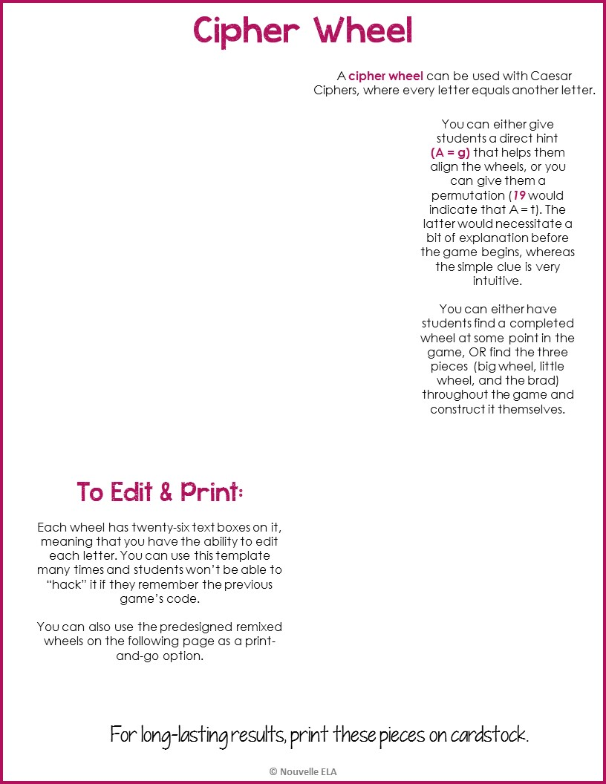
Z
A
B
Y
C
X
D
W
E
V
F
U
G
T
H
S
I
R
J
Q
K
P
O
M
L
N
y
z
a
b
c
x
d
w
e
v
f
u
g
t
h
s
i
r
j
q
l
k
p
o
n
m

Slide 29
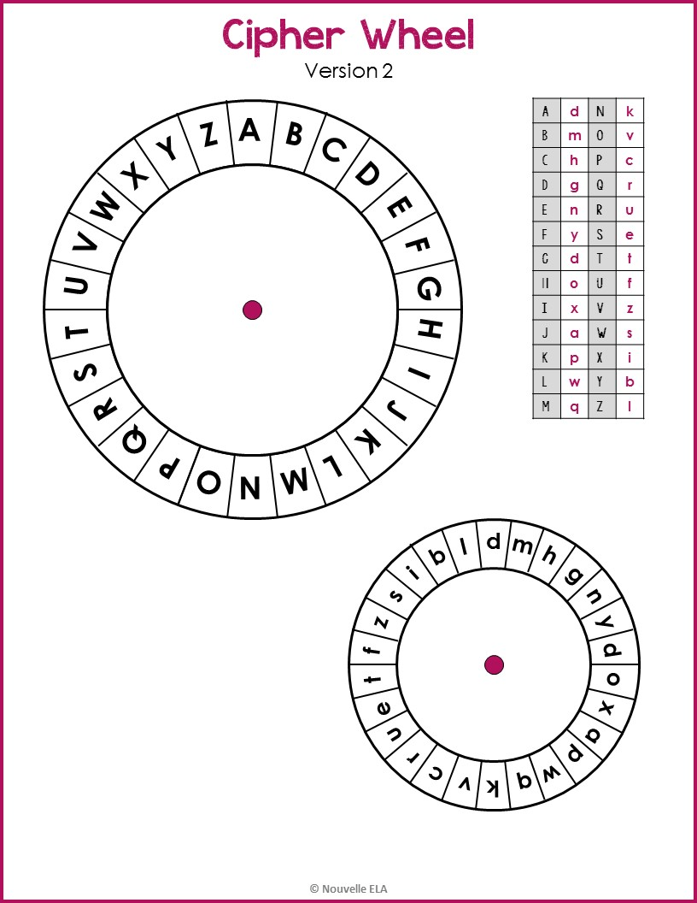

Slide 30


Slide 31
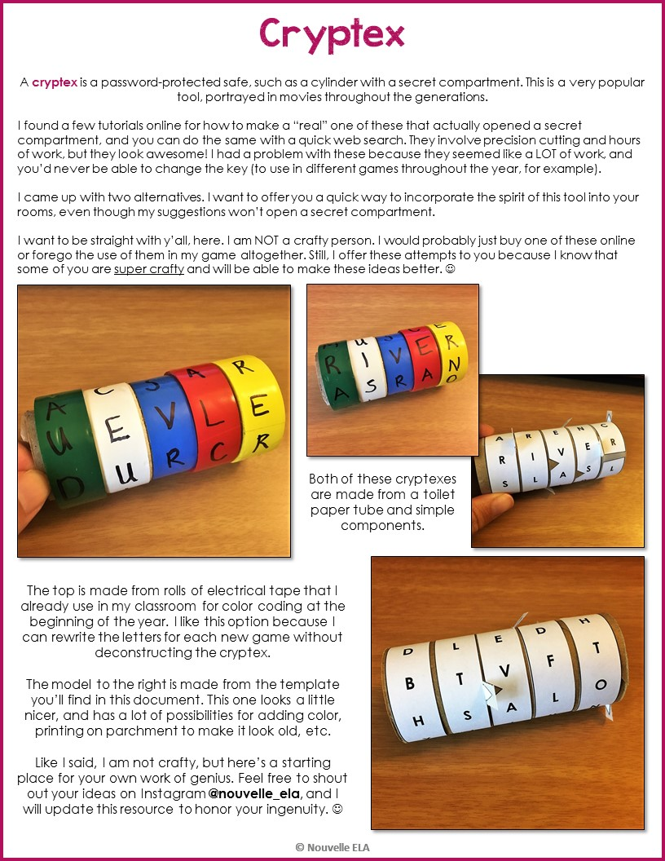

Slide 32

A | C | P | N | L
R | R | E | E | Y
S | I | T | S | H
D | L | E | D | T
B | T | V | F | O
H | S | A | L | N
Y | I | I | U | C
F | N | G | P | R
A | C | P | N | L
R | R | E | E | Y
S | I | T | S | H
D | L | E | D | T
B | T | V | F | O
H | S | A | L | N
Y | I | I | U | C
F | N | G | P | R
Use this template to make a Cryptex for a five letter code. Simply change the highlighted letters to be the code you want. Once this is done, make sure to change the Shading to “No Fill”. This makes 2/pg.
For best results, save as a .PDF before printing.
When you cut these strips, make sure to cut along the notches. They are randomly placed so that students can’t use them to “hack” the puzzle, but they will provide a grip for students to better move the strips. You can also place a small piece of tape on these to make them more durable.

Slide 33


Slide 34
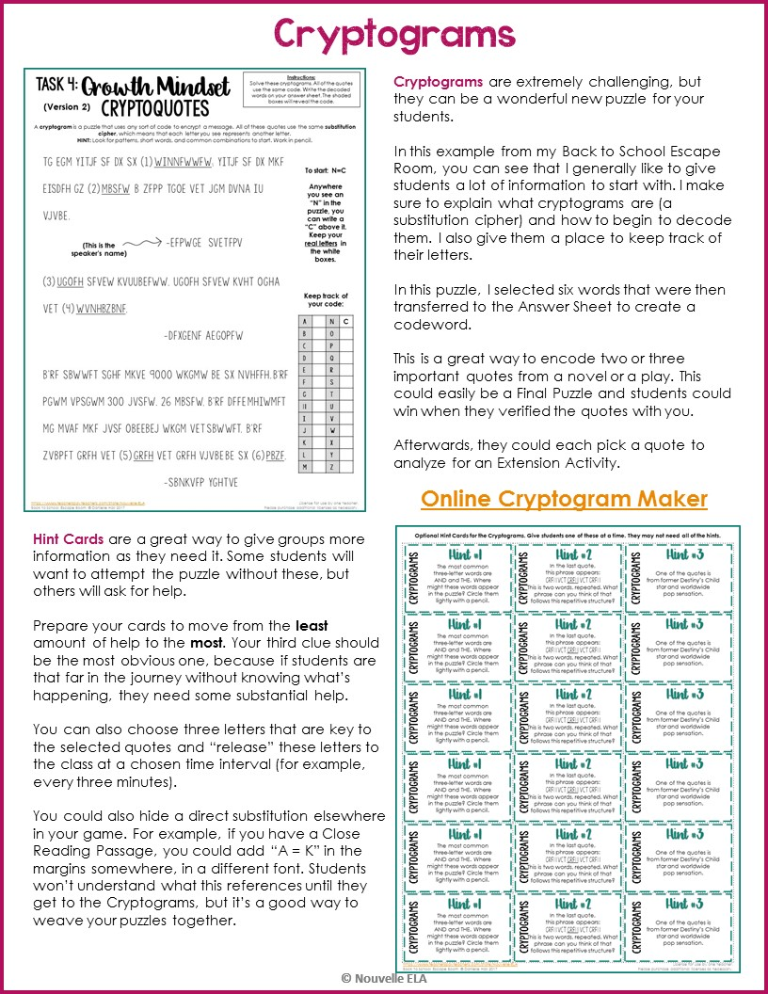

Slide 35
Title Here
Instructions:
Solve these cryptograms. All of the quotes use the same code. Write the decoded words on your answer sheet. The shaded boxes will reveal the code.
A cryptogram is a puzzle that uses any sort of code to encrypt a message. All of these quotes use the same substitution cipher, which means that each letter you see represents another letter.
HINT: Look for patterns, short words, and common combinations to start. Work in pencil.
Quotes here.
(Be sure to double-space your quotes to give students room to write above them)
To start: N=C
Anywhere you see an “N” in the puzzle, you can write a “C” above it. Keep your real letters in the white boxes.
(This is the speaker’s name)
Make sure to edit your starting letter. ☺
Keep track of your code:
A |  | N | C
B |  | O
C |  | P
D |  | Q
E |  | R
F |  | S
G |  | T
H |  | U
I |  | V
J |  | W
K |  | X
L |  | Y
m |  | Z

Slide 36
Optional Hint Cards for the Cryptograms. Give students one of these at a time. They may not need all of the hints.
The most common three-letter words are AND and THE. Where might these words appear in the puzzle? Circle them lightly with a pencil. | In the last quote, this phrase appears: grfh vEt grfh vEt grfh This is two words, repeated. What phrase can you think of that follows this repetitive structure? | One of the quotes is from former Destiny’s Child star and worldwide pop sensation.
The most common three-letter words are AND and THE. Where might these words appear in the puzzle? Circle them lightly with a pencil. | In the last quote, this phrase appears: grfh vEt grfh vEt grfh This is two words, repeated. What phrase can you think of that follows this repetitive structure? | One of the quotes is from former Destiny’s Child star and worldwide pop sensation.
The most common three-letter words are AND and THE. Where might these words appear in the puzzle? Circle them lightly with a pencil. | In the last quote, this phrase appears: grfh vEt grfh vEt grfh This is two words, repeated. What phrase can you think of that follows this repetitive structure? | One of the quotes is from former Destiny’s Child star and worldwide pop sensation.
The most common three-letter words are AND and THE. Where might these words appear in the puzzle? Circle them lightly with a pencil. | In the last quote, this phrase appears: grfh vEt grfh vEt grfh This is two words, repeated. What phrase can you think of that follows this repetitive structure? | One of the quotes is from former Destiny’s Child star and worldwide pop sensation.
The most common three-letter words are AND and THE. Where might these words appear in the puzzle? Circle them lightly with a pencil. | In the last quote, this phrase appears: grfh vEt grfh vEt grfh This is two words, repeated. What phrase can you think of that follows this repetitive structure? | One of the quotes is from former Destiny’s Child star and worldwide pop sensation.
The most common three-letter words are AND and THE. Where might these words appear in the puzzle? Circle them lightly with a pencil. | In the last quote, this phrase appears: grfh vEt grfh vEt grfh This is two words, repeated. What phrase can you think of that follows this repetitive structure? | One of the quotes is from former Destiny’s Child star and worldwide pop sensation.
Hint #1
Hint #2
Hint #3
CRYPTOGRAMS
CRYPTOGRAMS
CRYPTOGRAMS
To Edit:
Select any text box to edit. You may choose to leave Hint #1 the same, and edit #2 & #3.
Delete these instructions to begin. ☺
Hint #1
Hint #2
Hint #3
CRYPTOGRAMS
CRYPTOGRAMS
CRYPTOGRAMS
Hint #1
Hint #2
Hint #3
CRYPTOGRAMS
CRYPTOGRAMS
CRYPTOGRAMS
Hint #1
Hint #2
Hint #3
CRYPTOGRAMS
CRYPTOGRAMS
CRYPTOGRAMS
Hint #1
Hint #2
Hint #3
CRYPTOGRAMS
CRYPTOGRAMS
CRYPTOGRAMS
Hint #1
Hint #2
Hint #3
CRYPTOGRAMS
CRYPTOGRAMS
CRYPTOGRAMS

Slide 37


Slide 38
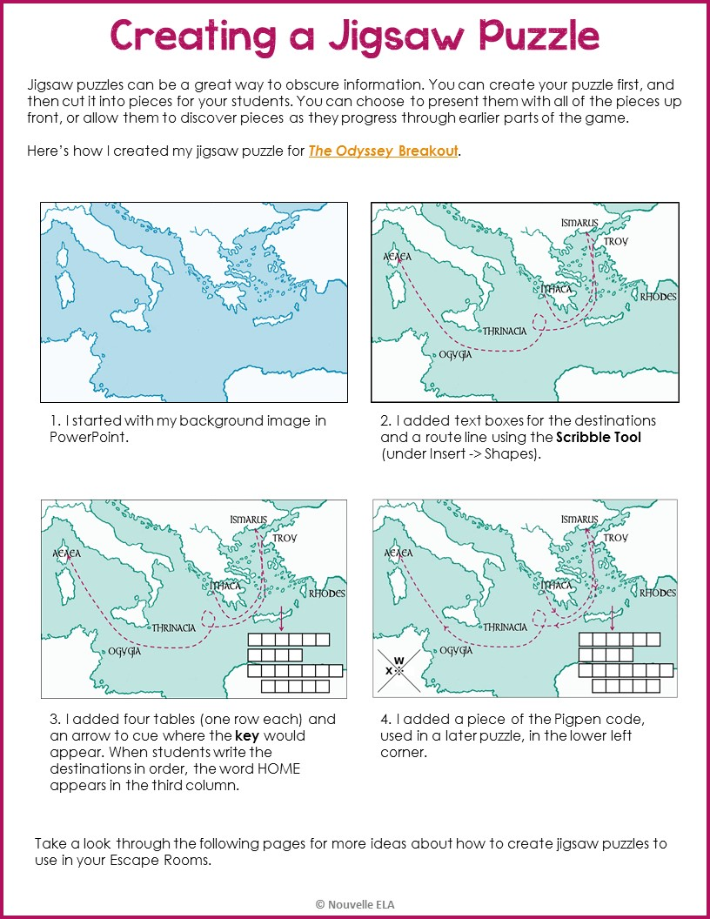

Slide 39
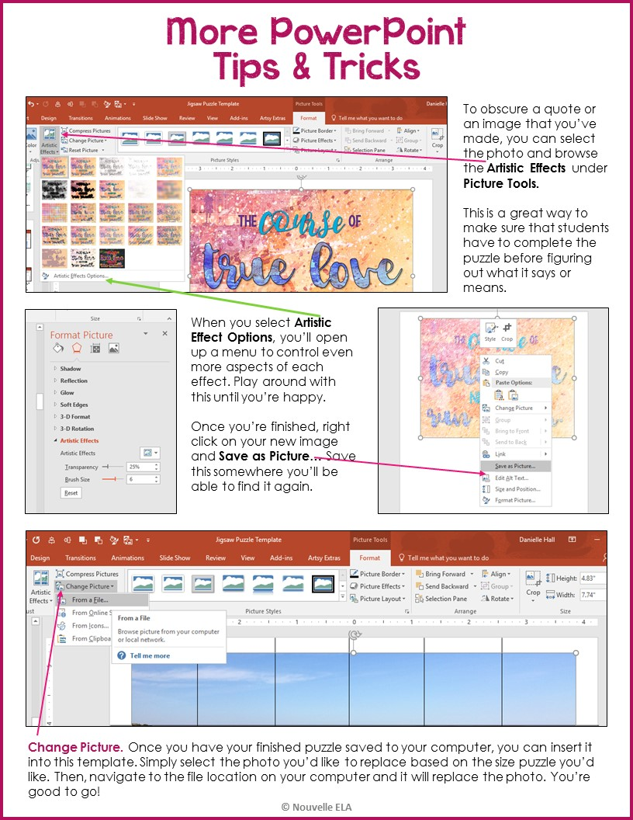

Slide 40
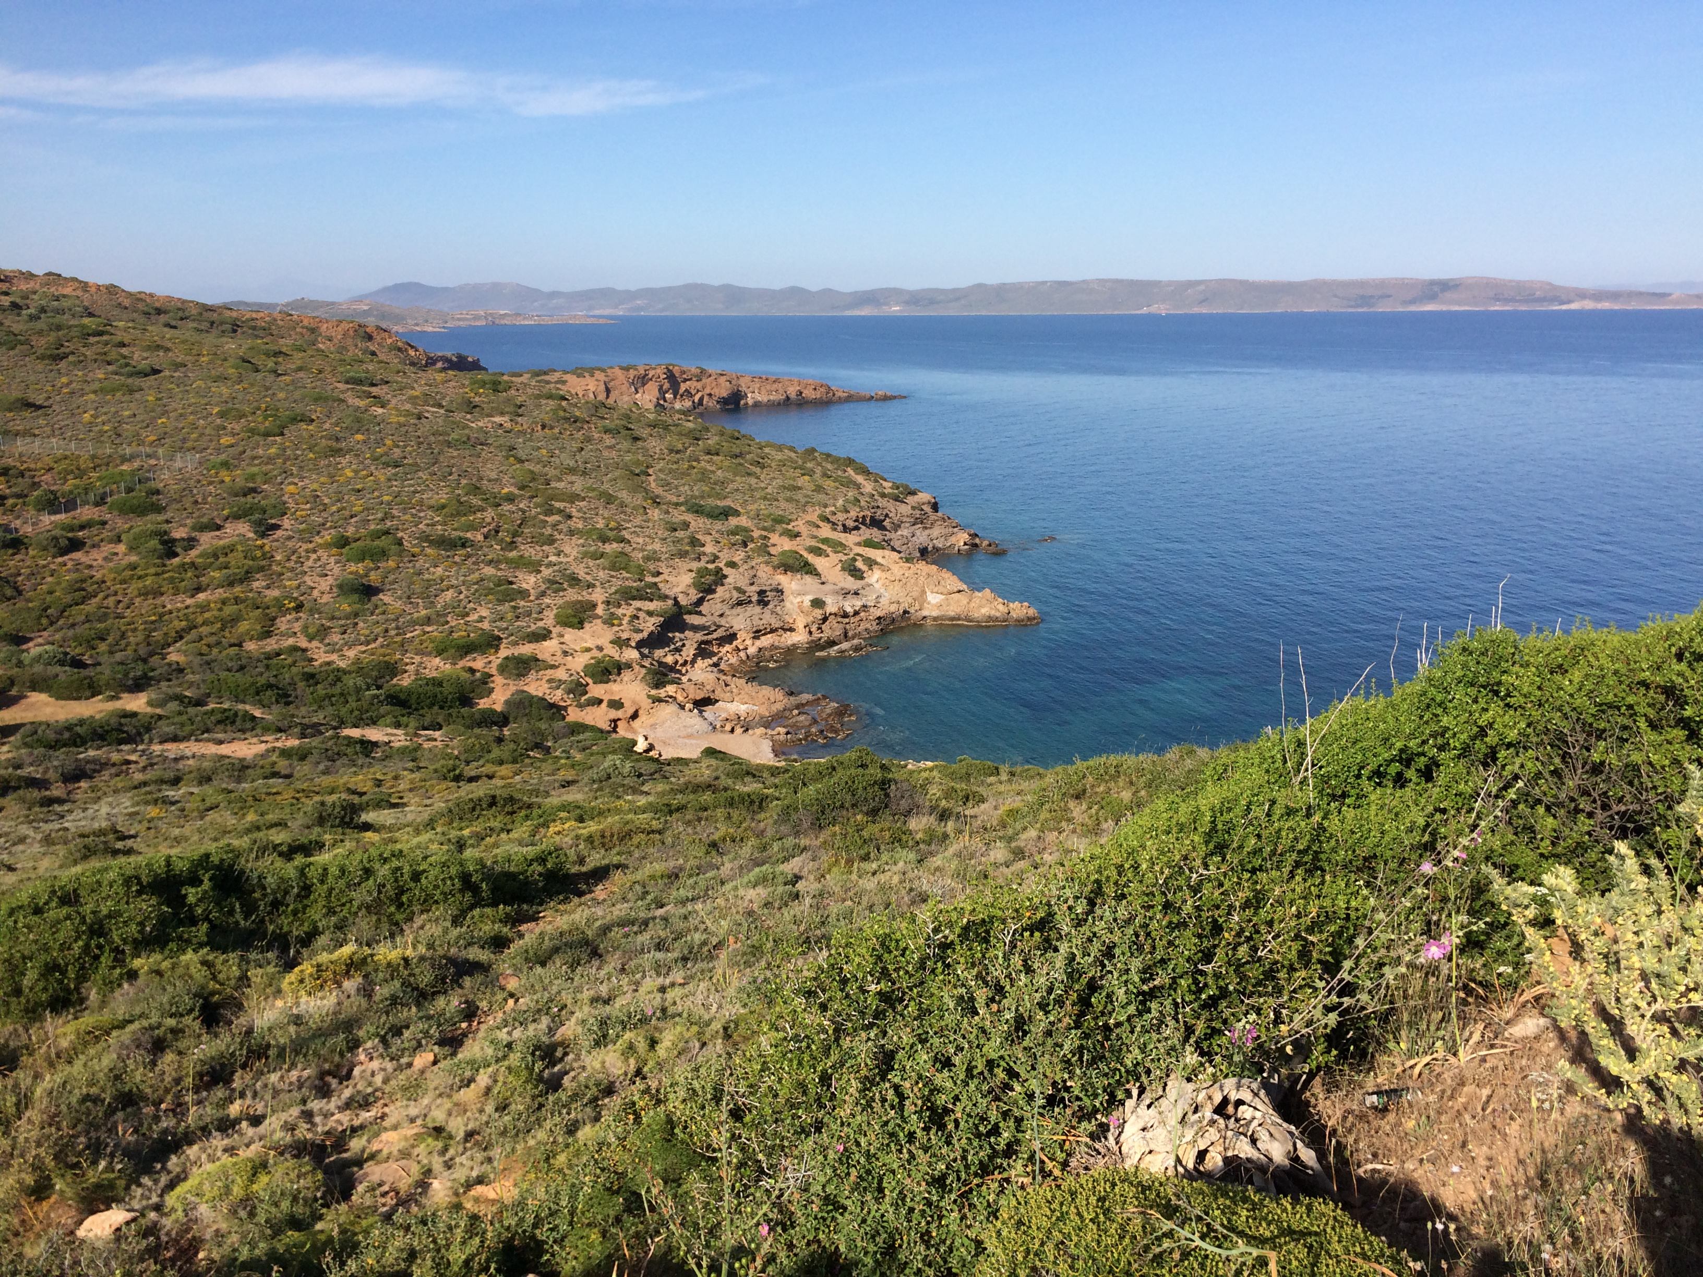

Slide 43
You could also have a smaller jigsaw consisting of one word, phrase, or number. Students could discover these pieces (perhaps on a distinct color paper) throughout the game.
Choose one of these strips, based on how many pieces you want. Write your message in the text box. Once you have your puzzle, you can Group these objects. Remember, to Group, you select the text box and the picture (hold down Ctrl while you click both objects) and select Group in the Drawing Tools tab. Then, you can copy and paste multiple times on the page.
You can also create this effect by hand by typing a message (one copy per group in your class) and cutting the strips roughly by hand.
Write your message here.
Write your message here.
Write your message here.
Write your message here.

Slide 44


Slide 45
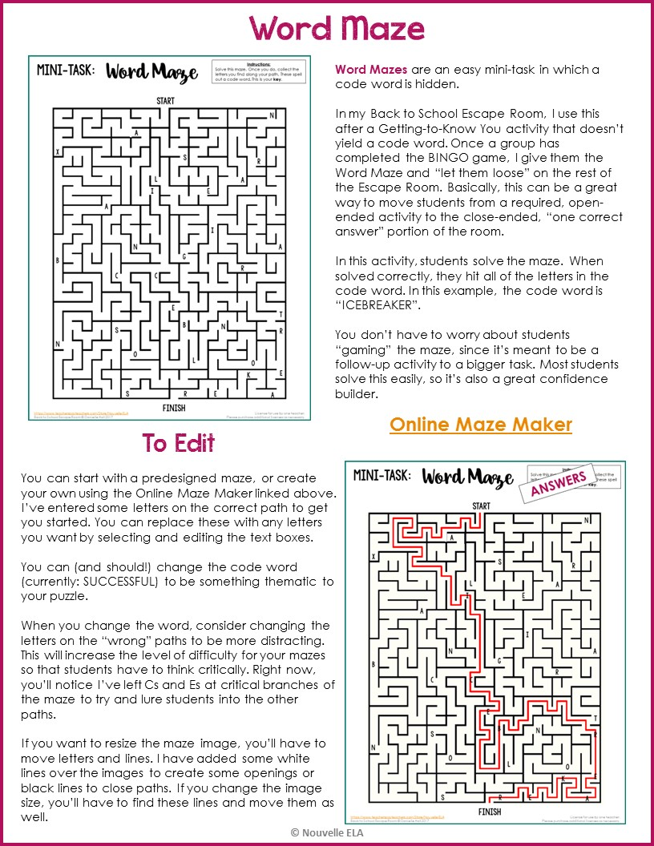

Slide 46

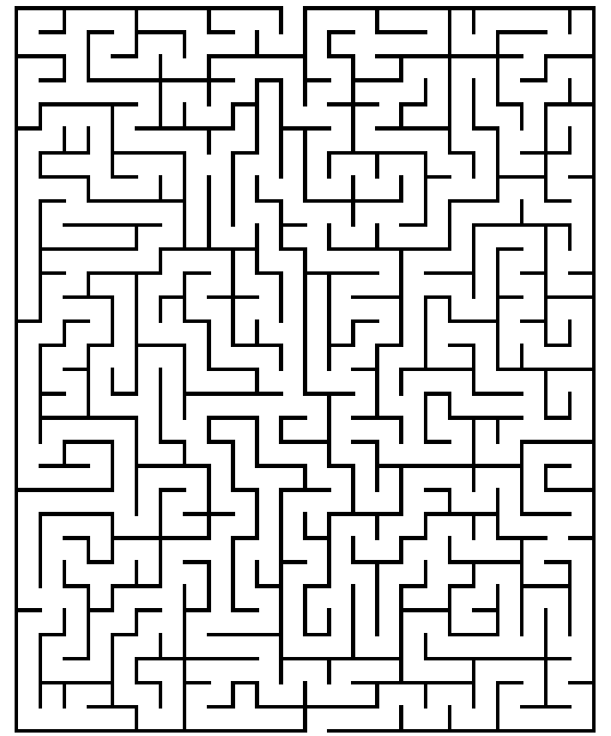
MINI-TASK:
Instructions:
Solve this maze. Once you do, collect the letters you find along your path. These spell out a code word. This is your key.
START
N
A
X
Version 1
(easy)
Reminder:
You’ll need to save everything as
.pdf before you print.
(Delete this box)
S
R
l
A
I
E
A
I
N
A
B
G
R
C
C
E
T
S
B
N
R
N
O
l
O
K
E
T
R
E
A
FINISH

Slide 47
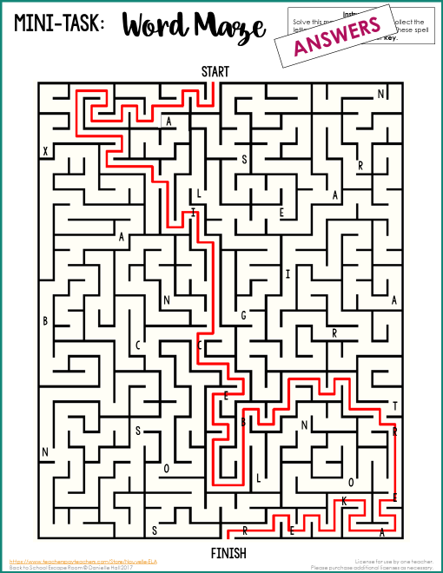

Slide 48
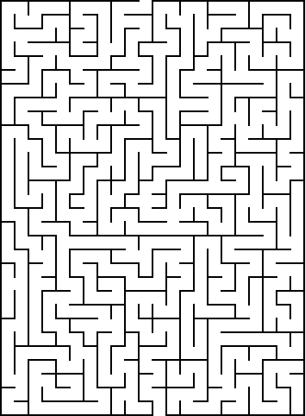
MINI-TASK:
Instructions:
Solve this maze. Once you do, collect the letters you find along your path. These spell out a code word. This is your key.
START
N
A
l
S
X
S
Version 2
(easy)
Current code word:
SUCCESSFUL
-- change for any ten-letter word, or eliminate letters for a shorter code word. Choose something that matches the theme of your room.
(Delete this box)
R
U
C
E
E
C
I
A
C
E
N
A
B
G
R
C
C
S
E
S
T
B
U
F
S
R
N
O
l
U
O
R
K
E
T
L
E
A
FINISH

Slide 49
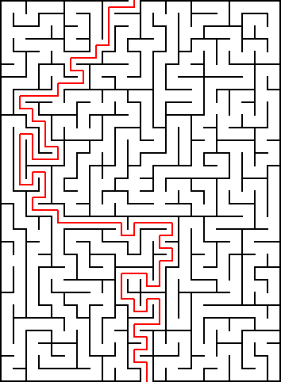
MINI-TASK:
Instructions:
Solve this maze. Once you do, collect the letters you find along your path. These spell out a code word. This is your key.
START
N
A
l
S
X
S
R
U
C
Version 2
(easy)
ANSWERS
(Delete this box)
E
E
C
I
A
C
E
N
A
B
G
R
C
C
S
E
S
T
B
U
F
S
R
N
O
l
U
O
R
K
E
T
L
E
A
FINISH

Slide 50
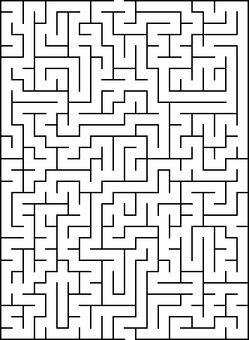
MINI-TASK:
Instructions:
Solve this maze. Once you do, collect the letters you find along your path. These spell out a code word. This is your key.
START
N
S
A
S
l
X
R
I
C
Version 3
(medium)
Current code word:
SUCCESSFUL
-- change for any ten-letter word, or eliminate letters for a shorter code word. Choose something that matches the theme of your room.
(Delete this box)
G
A
U
A
I
C
N
A
B
G
E
R
C
S
E
S
T
C
B
N
S
R
N
E
F
O
O
l
K
E
U
T
L
R
A
FINISH

Slide 51
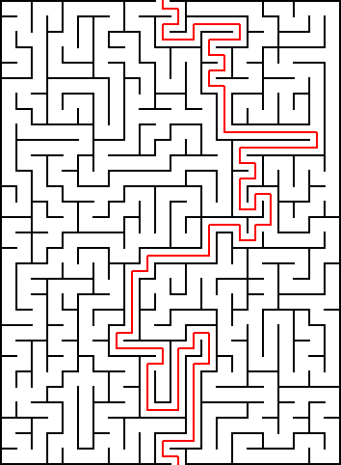
MINI-TASK:
Instructions:
Solve this maze. Once you do, collect the letters you find along your path. These spell out a code word. This is your key.
START
N
S
A
S
l
X
Version 3
(medium)
ANSWERS
(Delete this box)
R
I
C
G
A
U
A
I
C
N
A
B
G
E
R
C
S
E
S
T
C
B
N
S
R
N
E
F
O
O
l
K
E
U
T
L
R
A
FINISH

Slide 52
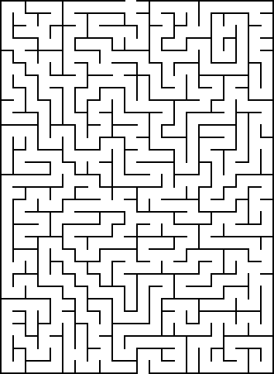
MINI-TASK:
Instructions:
Solve this maze. Once you do, collect the letters you find along your path. These spell out a code word. This is your key.
START
N
A
T
S
A
R
C
R
S
Version 4
(difficult)
Current code word:
SUCCESSFUL
-- change for any ten-letter word, or eliminate letters for a shorter code word. Choose something that matches the theme of your room.
(Delete this box)
E
E
E
U
A
S
I
A
N
R
G
C
C
C
F
E
T
S
B
S
N
R
U
F
B
O
l
O
K
E
l
T
L
A
FINISH

Slide 53
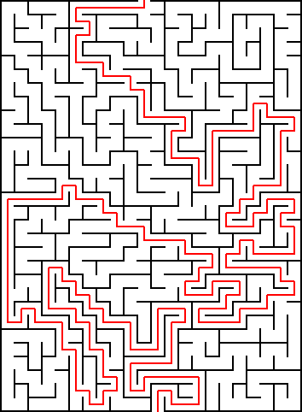
MINI-TASK:
Instructions:
Solve this maze. Once you do, collect the letters you find along your path. These spell out a code word. This is your key.
START
N
A
T
S
C
A
Version 4
(difficult)
ANSWERS
(Delete this box)
R
R
S
E
E
E
U
A
S
I
A
N
R
G
C
C
C
F
E
T
S
B
S
N
R
U
F
B
O
l
O
K
E
l
T
L
A
FINISH

Slide 54
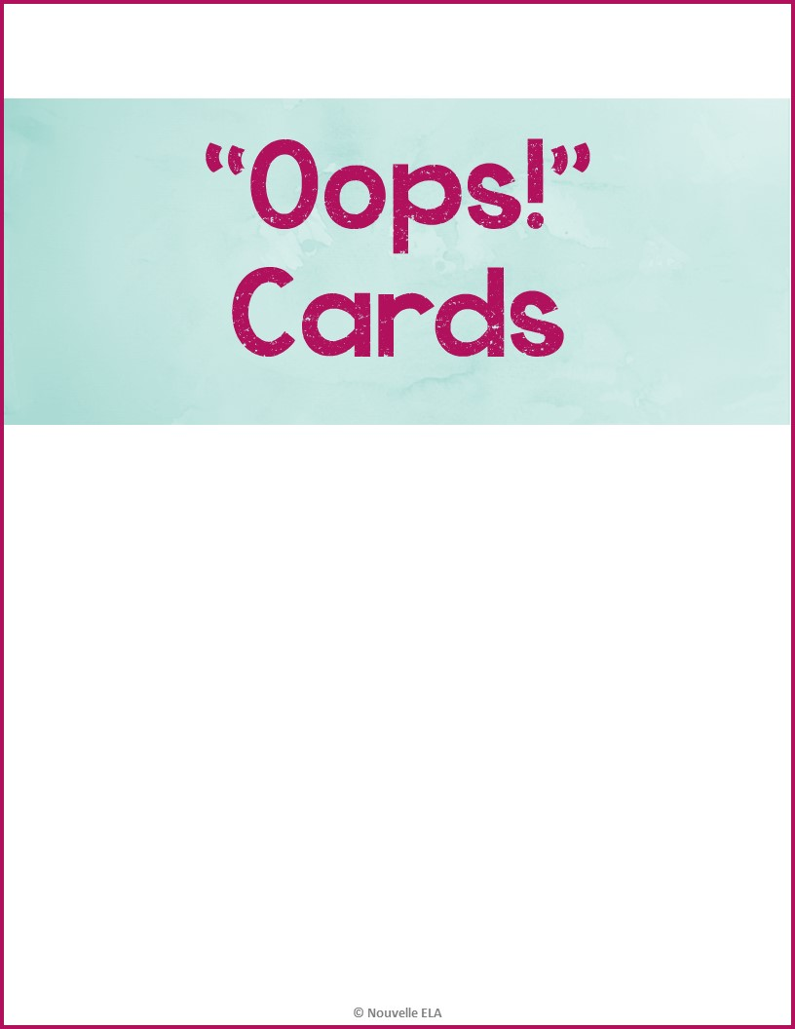

Slide 55
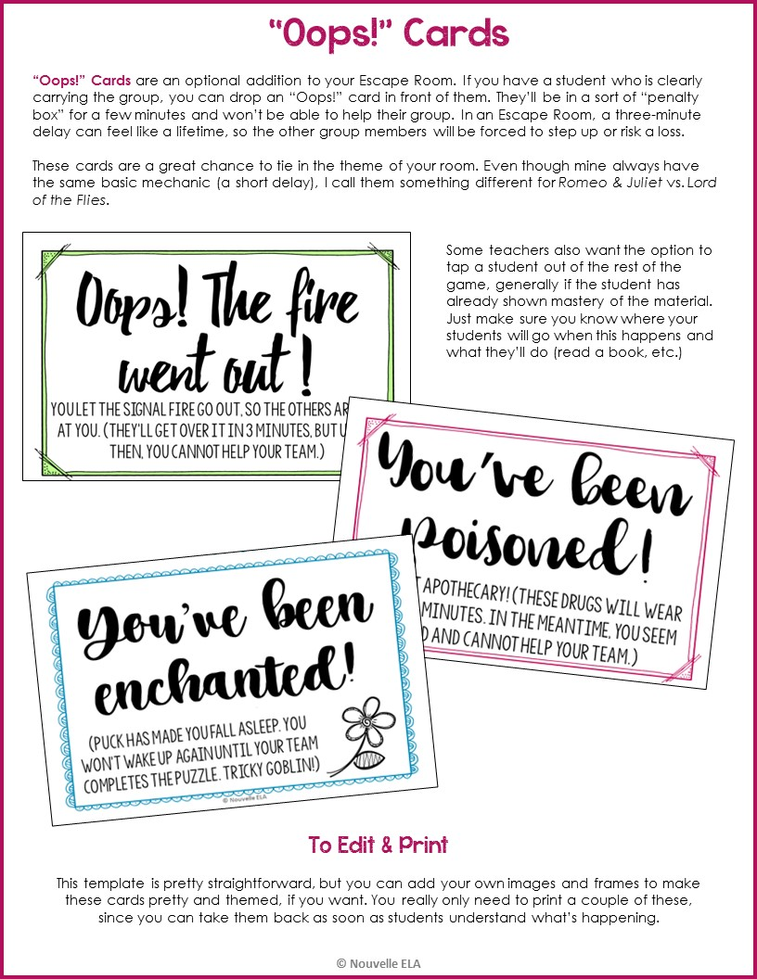

Slide 56
Oops! You let the signal fire go out!
Make this penalty thematic for your room. ☺
Copy & Paste to duplicate for the bottom half.
Everyone is mad at you and exiles you for 5 minutes. Until the end of this time, you cannot help your team.

Slide 57


Slide 58
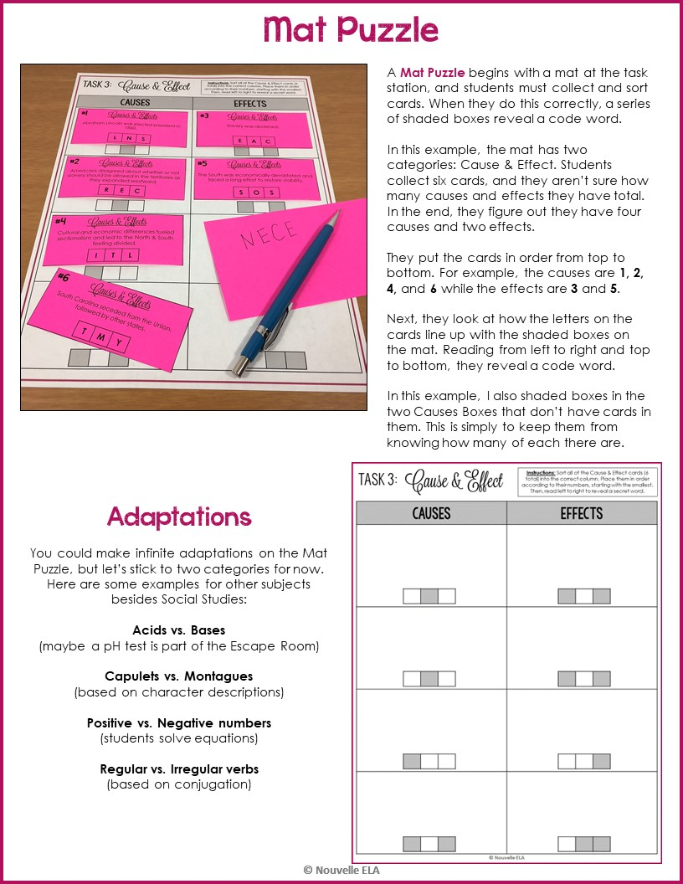

Slide 59

Causes | Effects
STEP 1: Make your list of causes and effects for whatever
content you’re working with. You should have six total,
but this can be divided however you want.
Abraham Lincoln was elected president in 1860.
Slavery was abolished.
L | N | S
E | A | C
STEP 2: Choose your code word. If you have students decode a message, this could be one of the words they’ll need. I chose “necessity” because I will have students work with a Grant quote including this word in Task #4.
Americans disagreed about whether or not slavery should be allowed in the territories as they expanded westward.
The South was economically devastated and faced a long effort to restore stability.
R | E | C
S | O | S
STEP 3: Write your code word with one or two letters per card. “Shade” those boxes under the Design Tab in PPT. Fill in the rest of the letters with distractors. Make sure to shade some boxes in your extra causes/effects spaces so that students don’t know how many of each they need.
Cultural and economic differences fueled sectionalism and led to the North & South feeling divided.
I | T | L
STEP 4: Shade the appropriate boxes on your Mat. Copy the boxes with letters to the appropriate card on your Clue Cards page. Turn the shading back to white. (You can also just type in the letters by hand on the correct cards) Remember that you can assign any numbers to your clues as long as they end up in order on the mat. (for instance, my causes are 1 – 2 – 4 – 6 and my effects are 3 – 5)
South Carolina seceded from the Union, followed by other states.
T | M | Y

Slide 60
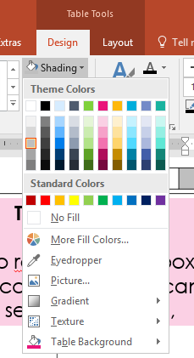
TASK 3:
Cause & Effect
Instructions: Sort all of the Cause & Effect cards (6 total) into the correct column. Place them in order according to their numbers, starting with the smallest. Then, read left to right to reveal a secret word.
Causes | Effects
Task Mat
You’ll need to reshade these boxes to match your code word. You can do this by selecting the cell, going to Table Tools → Design → Shading.
(Delete this box & image)

Slide 61
Causes & Effects
#1
Causes & Effects
#4
Abraham Lincoln was elected president in 1860.
Cultural and economic differences fueled sectionalism and led to the North & South feeling divided.
Clue Cards
Copy each cause & effect into the appropriate text box and the correct clue letters into the three-box for each card. When you’re finished, copy everything (Ctrl+A) and create a second set of Clue Cards on this page. That way, you’ll save paper in printing.
(Delete this box)
L | N | S
I | T | L
Causes & Effects
Causes & Effects
#2
#5
Americans disagreed about whether or not slavery should be allowed in the territories as they expanded westward.
The South was economically devastated and faced a long effort to restore stability.
R | E | C
S | O | S
Causes & Effects
Causes & Effects
#3
#6
Slavery was abolished.
South Carolina seceded from the Union, followed by other states.
E | A | C
T | M | Y

Slide 62
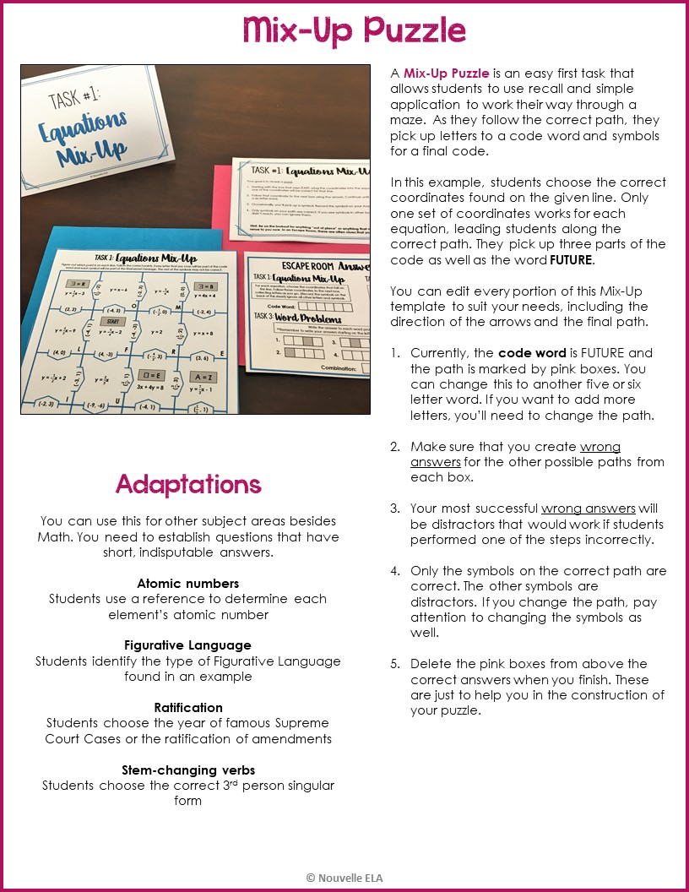

Slide 63




















Task 1: Equations Mix-Up
Figure out which point is on each line. Follow the correct points. Every letter that you cross will be part of the code word and each symbol will be part of the final secret message. The rest of the symbols may not be correct.
M = R
M = B
($\frac{1}{5}$, -2)
y = -$\frac{3}{4}$x
y = x – 6
(0, 0)
y = $\frac{1}{2}$x – 3
(-2, 3)
y = 4x + 4
O
M
(2, 2)
(-4, 3)
(- $\frac{1}{2}$, 0)
(-2, 4)
START
y = $\frac{2}{3}$x – 9
y = 2
($\frac{1}{5}$, 2)
(-4, 1)
(-4, -3)
y = x + 8
y = -$\frac{1}{4}$x – 2
L
F
(- $\frac{4}{3}$, 3)
R
E
(4, 0)
(4, -3)
(3, 6)
y = -$\frac{1}{2}$x + 2
($\frac{2}{3}$, 1)
E = E
Z = Z
(-3, 1)
y = $\frac{2}{3}$x
($\frac{3}{4}$, 3)
y = $\frac{7}{3}$x - 1
3x + 4y = 8
I
(-9, -6)
U
(-4, 1)
($\frac{1}{2}$ , 1)
(-2, 3)
y = 3
A = A
x = -4
y = 10x - 4
($\frac{2}{3}$, 1)
(1, -1)
(1, -4)
y = -$\frac{4}{3}$x + $\frac{1}{2}$
(2, 0)
N
(3, -$\frac{7}{2}$)
(-4, 6)
U
(2, 0)
E
A = W
($\frac{1}{5}$, -3)
W = W
($\frac{1}{5}$, 2)
(0, 0)
y = -5x - 2
y = -3x - 3
x = 2
$\frac{1}{2}$x + 2y = 10
T
A

